Slide 1

VI Capstone Project
By Nigel

Slide 2
Problem Statement
The number of customers terminating their credit card services are on the rise.
The bank wants to know the profile of these people, such as their education, marital status, income category & transaction amounts etc.
Ultimately, the bank wants to predict the people who are about to terminate their credit card services and implement a new retainment strategy using that data.

Slide 3
Benefits of the Data Charts
With the provided charts and graphs, we can visualize clearly the summary of the bank’s credit card services, as well as the profiles of the customers.
These charts can provide the bank with a clearer indicator of customers that are about to leave the services; or have a higher chance of doing so.

Slide 4
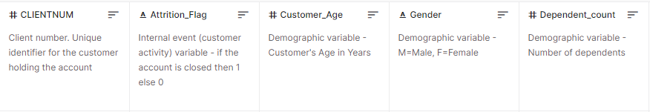
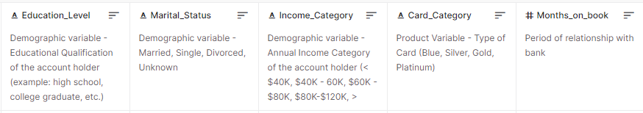
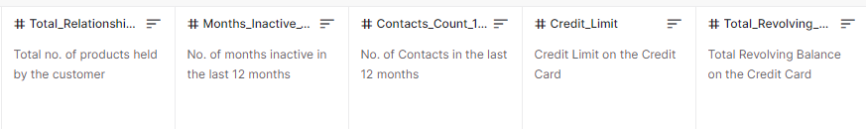
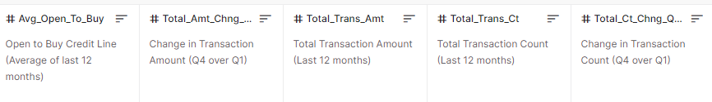
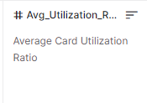
Dataset
The data used in this project was taken from Kaggle:
https://www.kaggle.com/datasets/sakshigoyal7/credit-card-customers

Slide 5
Tableau – Live version available here
https://public.tableau.com/views/VICapstoneProject_16711104415370/CapstoneProject?:language=en-US&publish=yes&:display_count=n&:origin=viz_share_link

Slide 6
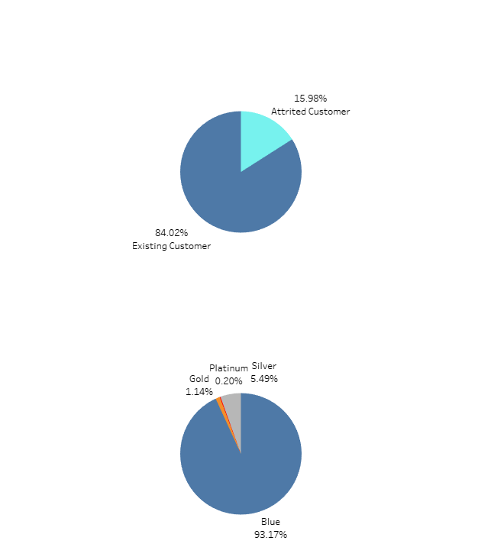


Data/Charts Explanation
In the first slide, we have the bank’s profile as well as customer’s credit card categories.
From the charts, we can tell that the attrition rate is approximately 16%.
We can also tell that a majority of the card holders are under the “Blue” Card Category.

Slide 7
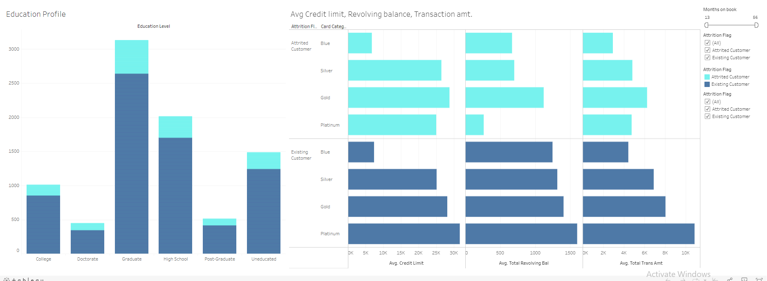
Data/Charts Explanation
The first part of the next slide shows the customers’ attrition rate according to their education level. From here, we can tell that a big portion of card holders fall under the “Graduate” category. We can also see that this category has the highest attrition rate.
On the second chart, we can see the customers credit limit, revolving balance as well as the transaction amounts. By average, the attrited customers has a lower credit limit, lower total revolving balance & lower total transacted amount.

Slide 8
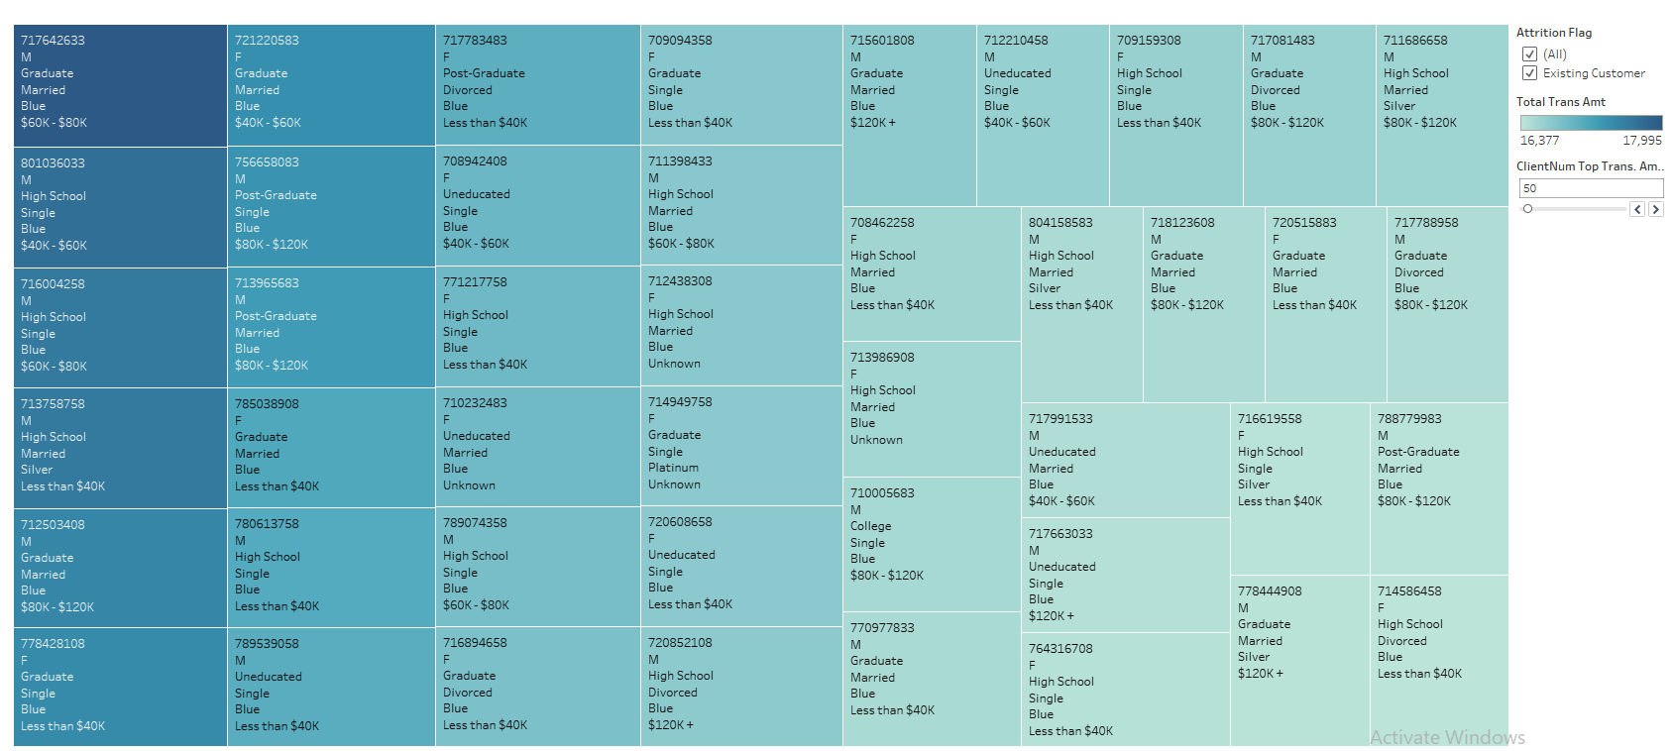
Data/Charts Explanation
On the third slide, we can see the customers’ transaction amounts based on their profiles, such as gender, marital status, education etc. in a tree map.
From here, we can see that many of the top transaction amounts consist of existing customers and rarely the attrited customers (since it does not show up in the top few attrition flag filter).

Slide 9
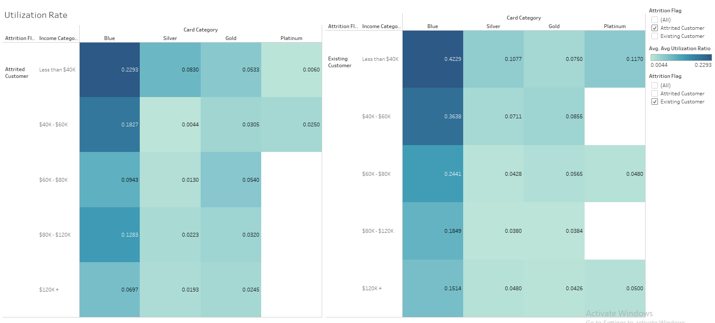
Data/Charts Explanation
On the last slide, the heatmap shows the utilization rates of the customers according to the card & income categories
From both attrited and existing customer tree maps, we can tell that the blue card with customers income < $40k has a high utilization rate. However, there is a significant difference between the utilization rate of the existing customers (0.42) and the attrited customers (0.22).

Slide 10
Possible conclusions
With all the relevant data provided, certain insights can be concluded as follows:
Since a big chunk of cardholders are graduates, a starting point could be to look from the financial situations of a graduate.
What are the financial struggles they face?
How or what services can the bank offer to this group of customers for a higher retainment rate?
A big percentage of the attrited customers have a low transaction amount, even though they are in the platinum category. Possible problems could be:
Are the offers/services provided at the highest category (Platinum) not attractive enough?
Are more customers dropping off after facing a similar situation?

Slide 11
THANK YOU

Slide 12
Appendix

Slide 13
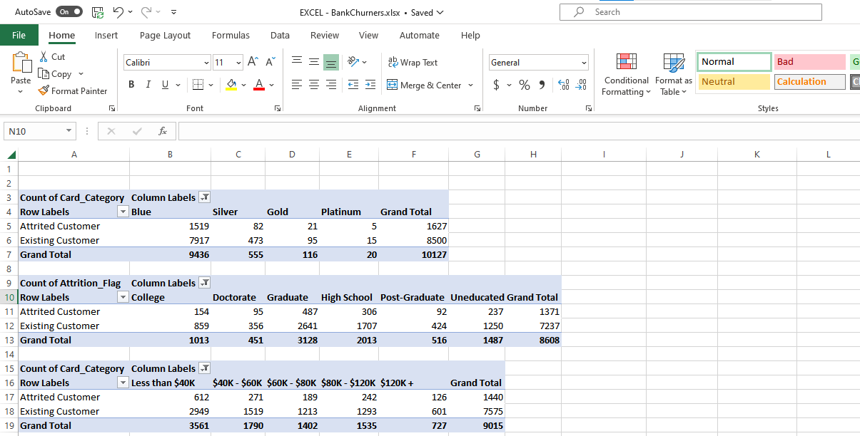
Visualizing using Excel – Pivot Table
Advantages: Ability to view the specific numbers in detail.

Slide 14
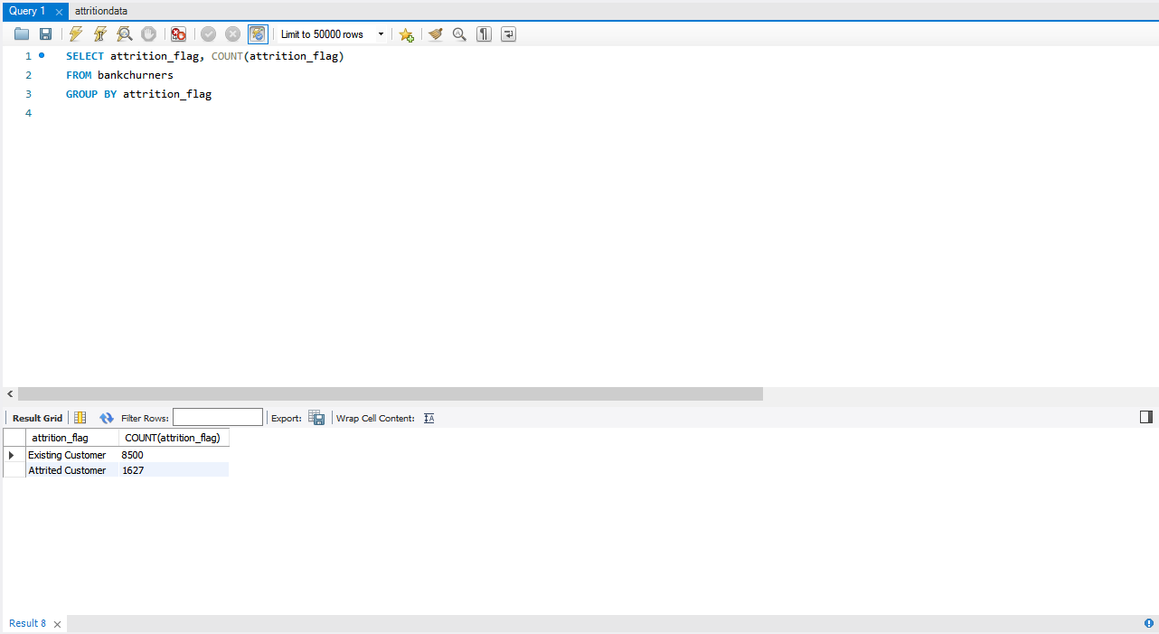
Visualizing using MySQL
Advantages: Ability to pull out and sort data simultaneously within a single query.

